Slide 1
Graph Neural Networks
Rong Zhang
Advisor: Prof. Jian-Jiun Ding
Group Meeting - 4/25/2023

Slide 2
Outline
Introduction

Slide 3
Introduction (1/5)
Graph Neural Networks (GNNs) is general form of most neural networks such as NNs, CNNs or RNNs, even unsupervised learning like RBM and DBNs.
Supervised
Unsupervised
GNNs
DBNs and RBM
DNNs
Fig. 1: Illustration of relations between GNNs and other networks.
RNNs
CNNs
AE
SNNs
GAN
Source: Self-made

Slide 4
Introduction (2/5)
Many machine learning tasks such as object detection [1], [2], machine translation [3], [4], and speech recognition [5], which once heavily relied on handcrafted feature engineering.
There is an increasing number of applications where data are represented in the form of graphs.
[1] J. Redmon, S. Divvala, R. Girshick, and A. Farhadi, “You only look once: Unified, real-time object detection,” in Proc. of CVPR, 2016, pp. 779–788.
[2] S. Ren, K. He, R. Girshick, and J. Sun, “Faster r-cnn: Towards realtime object detection with region proposal networks,” in Proc. of NIPS, 2015, pp. 91–99.
[3] M.-T. Luong, H. Pham, and C. D. Manning, “Effective approaches to attention-based neural machine translation,” in Proc. of EMNLP, 2015, pp. 1412–1421.
[4] Y. Wu, M. Schuster, Z. Chen, Q. V. Le, M. Norouzi, W. Macherey, M. Krikun, Y. Cao, Q. Gao, K. Macherey et al., “Google’s neural machine translation system: Bridging the gap between human and machine translation,” arXiv preprint arXiv:1609.08144, 2016.
[5] G. Hinton, L. Deng, D. Yu, G. E. Dahl, A.-r. Mohamed, N. Jaitly, A. Senior, V. Vanhoucke, P. Nguyen, T. N. Sainath et al., “Deep neural networks for acoustic modeling in speech recognition: The shared views of four research groups,” IEEE Signal processing magazine, vol. 29, no. 6, pp. 82–97, 2012.

Slide 5
Introduction (3/5)
In chemistry, molecules [6] are modeled as graphs, and their bioactivity needs to be identified for drug discovery [7].
In a citation network [8], papers are linked to each other via citation ships and they need to be categorized into different groups.
[6] Duvenaud, David K., et al. "Convolutional networks on graphs for learning molecular fingerprints." Advances in neural information processing systems 28 (2015).
[7] Nguyen, Thin, et al. "GraphDTA: predicting drug–target binding affinity with graph neural networks." Bioinformatics 37.8 (2021): 1140-1147.
[8] Shchur, Oleksandr, et al. "Pitfalls of graph neural network evaluation." arXiv preprint arXiv:1811.05868 (2018).

Slide 6
Introduction (4/5)
Message Passing Neural Networks [9], a variant of Graph Neural Networks, apply on quantum chemistry analysis and its application.
Further complex framework, such as Graph-ResNet [10], can distillate certain features from images.
Moment-Embedded Network (MoNet) [11], can efficiently embed multiple mixture models.
[9] Gilmer, Justin, et al. "Neural message passing for quantum chemistry." International conference on machine learning. PMLR, 2017.
[10] Guohao Li, Matthias Muller, Ali Thabet, Bernard Ghanem, “DeepGCNs: Can GCNsGoasDeepasCNNs”, ICCV, 2019.
[11] Gou, Mengran, et al. "Monet: Moments embedding network." Proceedings of the IEEE Conference on Computer Vision and Pattern Recognition. 2018.

Slide 7
Introduction (5/5)
Graph Neural Networks are also important components of Adversarial Attack [12] researching due to its characteristic of representing neural networks policies.
Graph Neural Networks can be applied on neural networks topology optimization by its general form of neural networks [13].
[12] Zügner, Daniel, et al. "Adversarial attacks on graph neural networks: Perturbations and their patterns." ACM Transactions on Knowledge Discovery from Data (TKDD) 14.5 (2020): 1-31.
[13] Xu, Kaidi, et al. "Topology attack and defense for graph neural networks: An optimization perspective." arXiv preprint arXiv:1906.04214 (2019).

Slide 8
Outline
Introduction
History

Slide 9
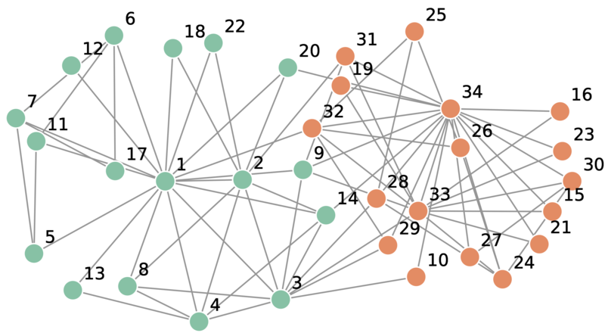
History (1/6)
A classic problem, The Karate Club [14], is a benchmark of graph data evaluations. The network captures 34 members of a karate club, documenting links between pairs of members who interacted outside the club.
Fig. 2: A network representation of social relationships among the 34 individuals in the karate club studied by Zachary [14].
[14] Zachary, Wayne W. "An information flow model for conflict and fission in small groups." Journal of anthropological research 33.4 (1977): 452-473.

Slide 10
History (2/6)
In 1997, Sperduti et al. (1997) [14] first applied neural networks to directed acyclic graphs, which motivated early studies on GNNs.
The first GNNs model being officially announced is in 2008 [15], which is comparably new compared with other classic models, such as CNNs (1980) and RNNs (1986).
[14] A. Sperduti and A. Starita, “Supervised neural networks for the classification of structures,” IEEE Transactions on Neural Networks, vol. 8, no. 3, pp. 714–735, 1997.
[15] Scarselli, Franco, et al. "The graph neural network model." IEEE transactions on neural networks 20.1 (2008): 61-80.

Slide 11
History (3/6)
A brief timeline of neural network history.
1950
1960
1970
1980
1990
2000
2010
2020
Transformers
Gradient Descent
Convolutional Nets
Adversarial Attack
Back Propagation
Attention Mechanics
Self-Organized Maps
Support Vector Machine
Graph Neural Network
Contrastive Divergence
Concept of neural networks*
Multiple-layer Propagation
Long-Short-Terms Memories
Spiking Neural Network
Restricted Boltzmann Machine
Generative Adversarial Network
* The Organization of Behavior by Do Hebb.

Slide 12
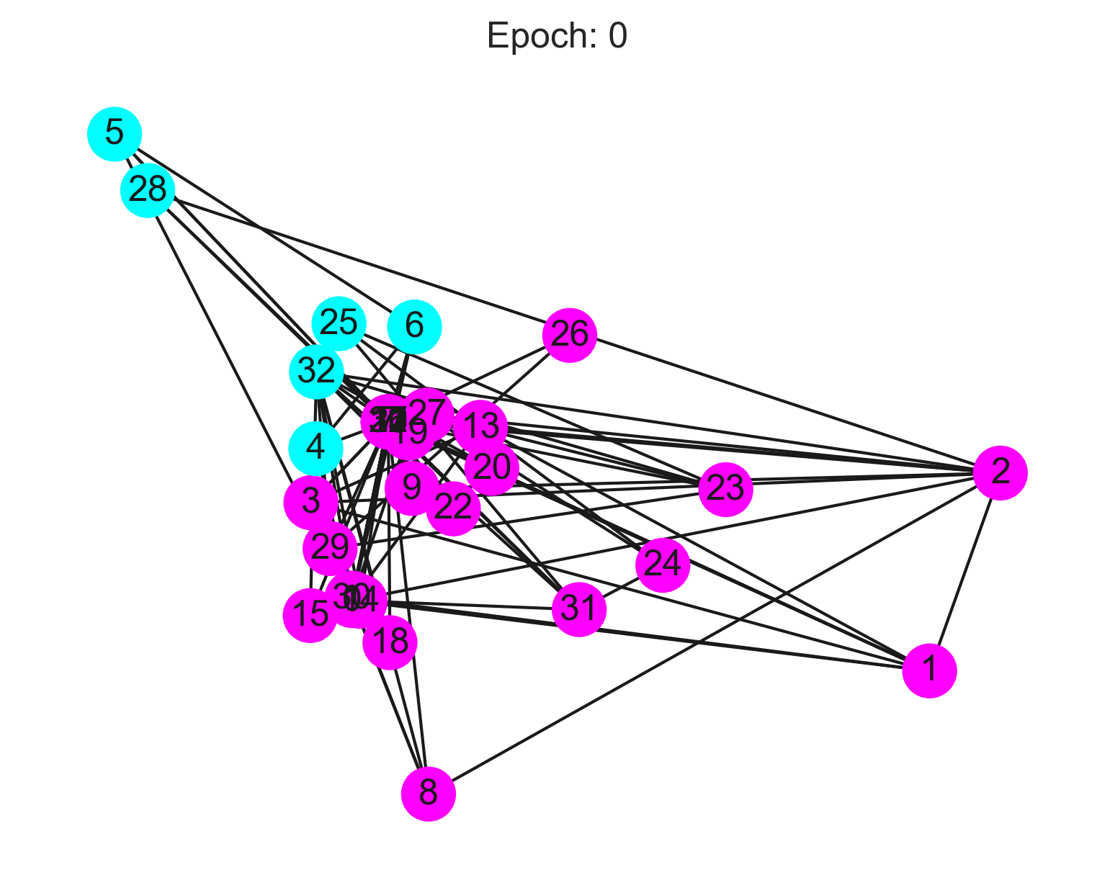
History (4/6)
The Karate Club is a simple binary relation problem, by applying GNNs model, we can easily categorize two clubs.
Fig. 3: The iteration of nodes by using GNNs model to categorize 34 individuals into two clubs from The Karate Club problem [16], [17].
[16] https://github.com/Steboss/learn_graph_ml
[17] Scarselli, Franco, et al. "The graph neural network model." IEEE transactions on neural networks 20.1 (2008): 61-80.

Slide 13
History (5/6)
Despite relations of nodes, GNNs also imply on embedding nodes data from regular vector domain.
Graph neural networks vs. network embedding
GNNs can address the network embedding problem through a graph autoencoder framework.
Network embedding contains other non-deep learning methods such as matrix factorization [18], [19] and random walks [20].
[18] X. Shen, S. Pan, W. Liu, Y.-S. Ong, and Q.-S. Sun, “Discrete network embedding,” in Proc. of IJCAI, 2018, pp. 3549–3555.
[19] H. Yang, S. Pan, P. Zhang, L. Chen, D. Lian, and C. Zhang, “Binarized attributed network embedding,” in Proc. of ICDM. IEEE, 2018.
[20] B. Perozzi, R. Al-Rfou, and S. Skiena, “Deepwalk: Online learning of social representations,” in Proc. of KDD. ACM, 2014, pp. 701–710.

Slide 14
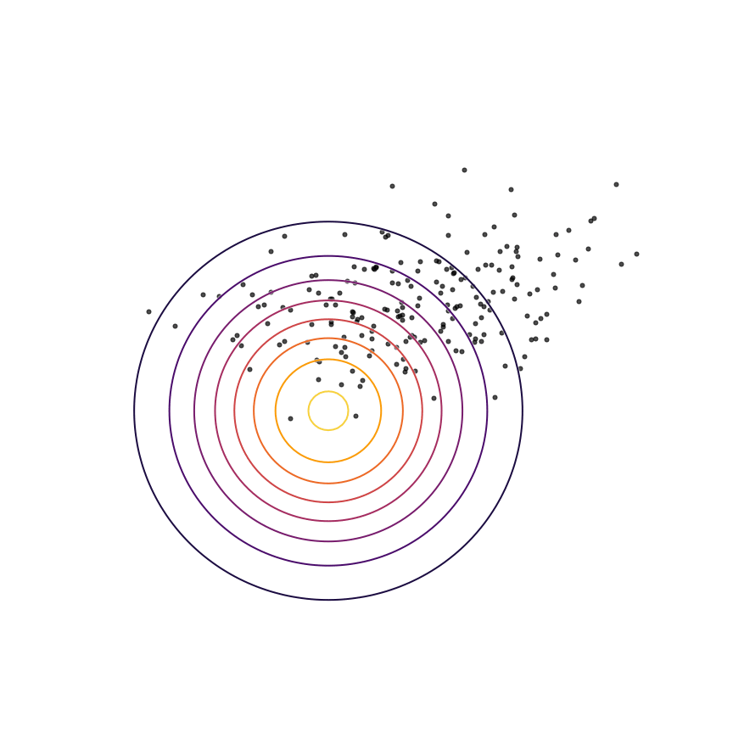
History (6/6)
GNNs also can map non-Euclidean data to vector spaces spanned by standard basis [21], which is embedding network, a problem that GNNs handled in its early stage.
Fig. 4: A simple case of KL-divergence minimization [21].
[21] Shannon, Claude E. "A mathematical theory of communication." The Bell system technical journal 27.3 (1948): 379-423..

Slide 15
Outline
Introduction
History
Definition

Slide 16
Definition (1/4)
TABLE I: Commonly used notations.
Notations | Descriptions
G | A graph.
V | The set of nodes in a graph.
E | The set of edges in a graph.
N | The neighbors of a node.
A | The graph adjacency matrix.
K | Incident matrix.
D | The degree matrix of A.
$$X∈ℝ^{n×d}$$ | The feature matrix of a graph.
$$H∈ℝ^{n×b}$$ | The node hidden feature matrix.

Slide 17
Definition (2/4)
Directed Graph
A directed graph is a graph with all edges directed from one node to another.
A graph is undirected if and only if the adjacency matrix is symmetric.
Spatial-Temporal Graph
A spatial-temporal graph is an attributed graph where the node attributes change dynamically over time.
Heterogeneous Graph [22]
[22] Wang, Xiao, et al. "Heterogeneous graph attention network." The world wide web conference. 2019.

Slide 18
Definition (3/4)
Dynamic graph
Diffusion Convolutional Recurrent Neural Network (DCRNN)
Hyper-graph
Signed-graph
Large-graph

Slide 19
Definition (4/4)
Gradient analysis of graph
$Suppose we have a graph 𝒢=N\left(V,E\right), then we have gradient of each nodes \left\{\overset{⃑}{n}=f | f∈V\right\}$
$$associated with edges \left\{\overset{⃑}{e}=\left(u,v\right) | u,v∈E\right\},∇_{N}={\overset{⃑}{e}}_{ij}^{T}f=K^{T}f,$$
$$then we compute divergence of graph:∇∙∇_{N}=KK^{T}f=L\left(f\right),$$
$$where L denotes harmonic matrix.$$
$Further, we obtain Dirichlet energy of a graph function$:
$$E:ℝ^{n}⟶ℝ^{n},E\left(f\right)=\frac{1}{2}\sum_{u\sim v}{w_{uv}{\left(f\left(u\right)−f\left(v\right)\right)}^{2}={\left\|A^{T}f\right\|}^{2}}=f^{T}Lf.$$

Slide 20
Outline
Introduction
History
Definition
Topology

Slide 21
Topology (1/8)
Type of Graph operators
TABLE II: Commonly used Modules of GNNs.
Type | Method | Layer
Propagation | Spectral Convolution | Graph Convolution
 | Spatial Convolution
 | Attention | Graph Attention
 | Recurrent Convergence | Graph Dense
 | Recurrent Gate | Graph LSTM
 | Skip Connection | Deep-GCN
Downsampling | Direct | Sort-Pooling
 | Hierarchical | gPool

Slide 22
Topology (2/8)
Recurrent Graph Network
In 2009, Scarselli et al. used RNNs to propagate directed acyclic graphs.
Recurrent graph uses $h∈R^{s}$ as hidden node features related to other neighbor nodes. The state embedding ℎ is an s-dimension vector of node v and can be used to produce an output $o$ such as the distribution of the predicted node label.
$Suppose we have node v and its neighbor nodes v_{N}, then we have:$
$h=f\left(x_{v},A_{v},h_{v_{N}},x_{v_{N}}\right),where A denotes Adjcency and f denotes feed−forward.$
$o=g\left(h_{v},x_{v}\right),where g can be interpreted as feed−forward.$

Slide 23
Topology (3/8)
Spectral Graph Convolution
$Suppose we have graph ℊ and trainable wight 𝓌, then we define graph$
$$convolution ℊ∗𝓌=ℱ^{−1}\left\{𝒢\left(f\right)𝒲\left(f\right)\right\},where ℱ denotes Fourier transform.$$
$$By ChebNet, we can simply the spectral equation as:$$
$$ℊ∗𝓌=\sum_{k=0}^{K}{𝒲_{k}𝒯_{k}\left(L\right)𝒢},where 𝒯 denotes Chebshev polynomial,$$
$$and L is eigenspace of normalize graph lapacian [23].$$
[23] Defferrard, Michaël, Xavier Bresson, and Pierre Vandergheynst. "Convolutional neural networks on graphs with fast localized spectral filtering." Advances in neural information processing systems 29 (2016).

Slide 24
Topology (4/8)
Spectral Graph Convolution
$In 2017, Kief et al. \left[24\right] further simplied the equation as:$
$Since we have graph lapacian L_{N}=I_{N}−D^{\frac{1}{2}}AD^{−\frac{1}{2}},$
$we can simply Chebnet as:\sum_{k=0}^{K}{𝒲_{k}𝒯_{k}\left(L\right)𝒢}≈𝒲_{0}𝒢+𝒲_{1}\left(L_{N}−I_{N}\right)𝒢$
$Finally, we have graph convolution:$
$$H=ℊ∗𝓌≈W\left(I+D^{\frac{1}{2}}AD^{−\frac{1}{2}}\right)X,$$
$$where D denotes the degree matrix of Adjcency A.$$
[24] Kipf, Thomas N., and Max Welling. "Semi-supervised classification with graph convolutional networks." arXiv preprint arXiv:1609.02907 (2016).

Slide 25
Topology (5/8)
Spatial Graph Convolution
$Given graph 𝒢=N\left(V,E\right) and \left\{v=x | vεV\right\},\left\{e_{v}=a_{v} | e∈E\right\},we have:$
$$h_{i}=\sum_{v∈N}{a_{v}w_{i}x_{v}}⟹H=AWX,$$
$$a simple equation of spatial graph convolution.$$
However, due to stability of gradient of convolution, a new propagation, Graph Attention [25] is announced to resolve the issues.
[25] Veličković, Petar, et al. "Graph attention networks." arXiv preprint arXiv:1710.10903 (2017).

Slide 26
Topology (6/8)
Graph Attention
Graph convolution often has gradient vanishing/exploding problems due to its adjacency weighting mechanic, especially when we have substantial nodes.
$For spatial graph convolution, we have H=AWX,to implement attention, we modify adjcency A as:$
$$\tilde{A}=softmax(σ\left(a^{T}\left[Wh_{i} | \left|Wh_{j}\right]\right)\right),where σ denotes activation,$$
$$a denotes adjcency and | denotes KL divergence.$$

Slide 27
Topology (7/8)
Graph Attention
Multi-head mechanic
To further ensure the stability, Vaswani et al. [26] suggested multi-head attention to graph attention.
$Suppose we have node v_{i} and{ v}_{j} with K heads, then for graph attention$
$between i and j, we have:$
$$H=\frac{1}{K}\sum_{k=1}^{K}{{\tilde{A}}_{k}W_{k}X_{ij}}$$
$$v_{j}$$
$$v_{i}$$
[26] Vaswani, Ashish, et al. "Attention is all you need." Advances in neural information processing systems 30 (2017).
Source: Self-made

Slide 28
Topology (8/8)
Nodes definition: Given a feature tensor with dimension $\{l,w,d\}$, we have $l×w$ nodes with $1×d$ feature vectors.
Edges definition: Adjacency matrix is used to represent edges, hetero-graph in Deep-Graph-Learning library or cosine similarity presents edges by computing similarity of nodes.
$$d$$
$$1×d$$
$$d$$
$$1×d$$
1
$$1$$
2
$$w$$
$$l×w$$
$$1×d$$
…
$$l×w$$
$$l$$
Source: Self-made

Slide 29
Outline
Introduction
History
Definition
Topology
Taxonomy

Slide 30
Taxonomy (1/10)
Graph Neural Networks have various variants to implement on different fields, such as GNNs (Recurrent), GCNs (Spectral) and GATs (Spatial).
By implementing different layers with features, we have various framework of graph neural network.

Slide 31
Taxonomy (2/10)
Type | Learning | Framework
Recurrent | Supervised | GNN [27]
 |  | Tree LSTM [28]
 |  | ESN [29]
 |  | GGNN [30]
Spatial or Spectral |  | GCN [31]
 |  | GAT [32]
 |  | MPNN [33]
 |  | Mo-Net [34]
 | Semi-Supervised | GAE [35]
 | Adversarial | ARGA [36]
 | Unsupervised | DGI [37]
 |  | Info-graph [38]
 |  | Multi-view [39]
 | Evolutionary | NAS [40]
 | Reinforcement
TABLE III: Types of GNNs.
Source: Self-made

Slide 32
Taxonomy (3/10)
Other special type of GNNs
Skip Connections
Deep-GCN [41]
Graph U-Net [42]
Highway GCN [43]
[41] Li, Guohao, et al. "Deepgcns: Can gcns go as deep as cnns?." Proceedings of the IEEE/CVF international conference on computer vision. 2019.
[42] Gao, Hongyang, and Shuiwang Ji. "Graph u-nets." international conference on machine learning. PMLR, 2019.
[43] Rahimi, Afshin, Trevor Cohn, and Timothy Baldwin. "Semi-supervised user geolocation via graph convolutional networks." arXiv preprint arXiv:1804.08049 (2018).

Slide 33
Taxonomy (4/10)
Graph neural network (2008)
$$x_{1}$$
$$x_{2}$$
$$2$$
$$Dense$$
$$Dense$$
$$1$$
$$Dense$$
$$Dense$$
$$o_{1}$$
$$o_{2}$$
Fig. 5: A simple illustration of GNN.
Source: Self-made

Slide 34
Taxonomy (5/10)
Graph convolutional network (2016)
$$X_{nd}$$
$$1×d$$
$$×$$
$$I+D^{\frac{1}{2}}AD^{−\frac{1}{2}}$$
$$2$$
$$1×d$$
$$1$$
$$Dense$$
$$H_{nb}$$
Fig. 6: A simple illustration of GCN.
Source: Self-made

Slide 35
Taxonomy (6/10)
Graph attention network (2017)
$$X_{nd}$$
$$Dense$$
$$Dense$$
$$1×d$$
$$×$$
$$h_{i}||h_{j}$$
$$2$$
$$1×d$$
$$1$$
$$Dense$$
$$H_{nb}$$
Fig. 7: A simple illustration of GAT.
Source: Self-made

Slide 36
Taxonomy (7/10)
Graph Auto-Encoder (2016)
$$X_{nd}$$
$$GCN$$
$$1×d$$
$$2$$
$$×$$
$$\tilde{A}=σ(HH^{T})$$
$$1×d$$
$$1$$
$$GCN$$
Fig. 8: A simple illustration of GAE.
Source: Self-made

Slide 37
Taxonomy (8/10)
$$𝒢_{n}$$
Graph U-net (2019)
$$X_{n}$$
$$𝒢_{n}$$
$${𝒢′}_{n}$$
$$Dense$$
$$GCN$$
$$GCN$$
$$A_{n}$$
$$Pooling$$
$$Up−sampling$$
$$Top−k$$
$$Down−sampling$$
$$GCN$$
$$GCN$$
$$Down−sampling$$
$$Pooling$$
$$Up−sampling$$
$$GCN$$
$$GCN$$
$${𝒢′}_{n}$$
Fig. 9: A simple illustration of Graph U-Net (left) and gPool (right).
Source: Self-made

Slide 38
Taxonomy (9/10)
Deep-GCNs (2019)
$$GCN,64$$
$$GCN,64$$
$$GCN,64$$
$$Pololing$$
$$GCN,128$$
$$GCN,128$$
$$GCN,128$$
$$GCN,128$$
$$GCN,128$$
$$GCN,128$$
$$Pololing$$
$$GCN,256$$
$$GCN,256$$
$$GCN,256$$
$$GCN,256$$
$$GCN,256$$
$$GCN,256$$
$$Pololing$$
$$GCN,512$$
$$GCN,512$$
$$GCN,512$$
$$Image$$
$$2x$$
$$4x$$
$$8x$$
$$16x$$
Fig. 10: A simple illustration of Res-GCN.
Source: Self-made

Slide 39
Taxonomy (10/10)
Adversarial Regularized Graph Auto-encoder (2018)
$$GCN$$
$$GCN$$
$$𝒢\sim X,A$$
$$×$$
$$\tilde{A}=HH^{T}$$
$$GCN$$
$$Real$$
$$𝒢\sim X,A (True)$$
$$+$$
$$Fake$$
Fig. 11: A simple illustration of ARGA.
Source: Self-made

Slide 40
Outline
Introduction
History
Definition
Topology
Taxonomy
Applications

Slide 41
Applications (1/5)
TABLE IV: Applications of GNNs.
Application | References
Graph Mining | [44][45]
Physics Modeling | [46][47][48]
Chemistry | [49][50]
Biology | [51][52][53]
Knowledge Graph | [54][55]
Traffic Network | [56][57]
Recommendation System | [58][59]

Slide 42
Applications (2/5)
Image Classification by using ImageNet [60]
Using Deep-GCNs to classify data from ImageNet.
TABLE V: Comparison on ImageNet of GNNs and Res-Net.
$$GCN Backbone$$
$$Fusion Block$$
$$MLP$$
 | People (%) | All (%)
Res-Net 50 | 92.3 | 75.1
Deep-GCNs | 97.5 | 82.5
$$Image$$
$$Labels$$
Source: Self-made

Slide 43
Applications (3/5)
Semantic Segmentation by using COCO dataset [61]
TABLE VI: Comparison on COCO segmentation of GNNs and Seg-Net.
 | Animals (AP) | Trees (AP) | All (AP)
Seg-Net | 89.6 | 83.4 | 58.3
GNN | 91.2 | 84.7 | 61.2
[61] https://cocodataset.org/#home
Source: Self-made

Slide 44
Applications (4/5)
Object detection by using COCO dataset
TABLE VII: Comparison on COCO object detection of GNNs and FPN.
 | People (AP) | All (AP)
FPN [62] | 87.6 | 49.7
GNN | 89.7 | 51.8
[62] Lin, Tsung-Yi, et al. "Feature pyramid networks for object detection." Proceedings of the IEEE conference on computer vision and pattern recognition. 2017.
Source: Self-made

Slide 45
Applications (5/5)
TABLE VIII: Some classic GNN models and their links.
Model | Code
Cheb-Net (2016) | [63]
GAE (2016) | [64]
GCN (2017) | [65]
Graph-Sage (2017) | [66]
GAT (2017) | [67]
MPNNs (2017) | [68]
Mo-Net (2017) | [69]
Source: Self-made

Slide 46
Outline
Introduction
History
Definition
Topology
Taxonomy
Applications
Conclusion

Slide 47
Conclusion
Now, you know one more tool to resolve problems.
Is your problem suitable for GNNs?
Or are your features suitable for graph processing?
Even if you’re not doing deep learning, is graph representation helpful for data you need to handle?
Unless…you are doing voice/speech/text recognition and enhancement, I will recommend Transformer instead.

Slide 48
The End of Presentation.

